Slide 1
A comparative analysis between Dijkstra's and Breadth First Search Algorithms.
By Jonathan Cho, Ayush Budhwani, Jon Paul Dongieux, and Patrice Maxwell

Slide 2
Introduction
Both algorithms are considered SSSP (Single Source Shortest Path).
A real world example of Dijkstra’s algorithm would be things like GPS and what not, finding the most efficient path from a starting location to a destination.
A real world example of BFS would be social media (connections aren’t weighted)
This presentation will focus on our parallelization of each algorithm, problems we ran into, comparing the parallel versions with it’s sequential counterpart, and lastly comparing the parallel Dijkstra’s algorithm with BFS.

Slide 3
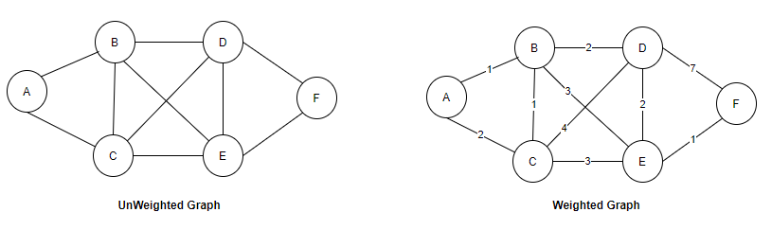
A quick refresher on Dijkstra’s algorithm and BFS
Both algorithms are algorithms that are used to find the shortest distance/path from the starting node to a target node.
For Dijkstra’s algorithm, the graph is weighted, meaning the edges that connect the vertices have a numerical value attached to each individual vertex.
However BFS is unweighted, and lacks that numerical value, which makes the edge more of a symbolic relation between different nodes.

Slide 4
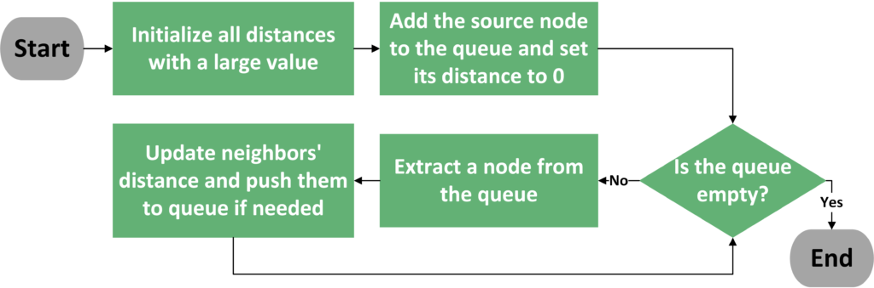
How do these algorithms work?
To understand their performances and why we’re comparing them, we must first know what each algorithm does.
Dijkstra’s:

Slide 5
How Dijkstra's Shortest Path Algorithm Works ?
Let's take an example….
1
5
1
0
3
Source
2
1
2

Slide 6
Dijkstra: Example
Visited:
Distances:
Vertex:
1
5
1
0
3
False
False
False
False
2
MAX
MAX
MAX
MAX
1
2
0
1
2
3
Current Vertex Adjacent Vertices Unvisited Vertices

Slide 7
Dijkstra: Example
minVertex = 0
Visited:
Distances:
Vertex:
minDistance: INT_MAX
1
5
1
0
3
True
False
False
False
2
0
MAX
MAX
MAX
1
2
0
1
2
3
Current Vertex Adjacent Vertices Unvisited Vertices

Slide 8
Dijkstra: Example
minVertex = 0
Visited:
Distances:
Vertex:
minDistance: INT_MAX
dist[minVertex] + graph(minVertex, v) < dist[v] 0 + 5 < MAX
minDistance: 5 minVertexFromAdjacentVertcies: 1
1
5
1
0
3
True
False
False
False
2
0
5
MAX
MAX
1
2
0
1
2
3
Current Vertex Adjacent Vertices Unvisited Vertices

Slide 9
Dijkstra: Example
minVertex = 0
Visited:
Distances:
Vertex:
minDistance: 5 dist[minVertex] + graph(minVertex, v) < dist[v] 0 + 1 < MAX minDistance: 1 minVertexFromAdjacentVertcies: 2
1
5
1
0
3
True
False
False
False
2
0
5
1
MAX
1
2
0
1
2
3
Current Vertex Adjacent Vertices Unvisited Vertices

Slide 10
Dijkstra: Example
minVertex = 2
Visited:
Distances:
Vertex: minDistance: INT_MAX dist[minVertex] + graph(minVertex, v) < dist[v] 1 + 2 < MAX minDistance: 3 minVertexFromAdjacentVertcies: 3
1
5
1
0
3
True
False
True
False
2
0
5
1
3
1
2
0
1
2
3
Current Vertex Adjacent Vertices Unvisited Vertices Processed Vertices

Slide 11
Dijkstra: Example
minVertex = 3
Visited:
Distances:
Vertex:
minDistance: INT_MAX dist[minVertex] + graph(minVertex, v) < dist[v] 3 + 1 < 5 minDistance: 4 minVertexFromAdjacentVertcies: 1
1
5
1
0
3
True
False
True
True
2
0
4
1
3
1
2
0
1
2
3
Current Vertex Adjacent Vertices Unvisited Vertices Processed Vertices

Slide 12
Dijkstra: Example
minVertex = 1
Visited:
Distances:
Vertex:
minDistance: INT_MAX
dist[minVertex] + graph(minVertex, v) < dist[v] minDistance: INT_MAX
1
5
1
0
3
True
True
True
True
2
0
4
1
3
1
2
0
1
2
3
Current Vertex Adjacent Vertices Unvisited Vertices Processed Vertices

Slide 13
Dijkstra: Example
Visited:
Distances:
Vertex:
Algorithm Complete!
1
5
1
0
3
True
True
True
True
2
0
4
1
3
1
2
0
1
2
3
Current Vertex Adjacent Vertices Unvisited Vertices Processed Vertices

Slide 14
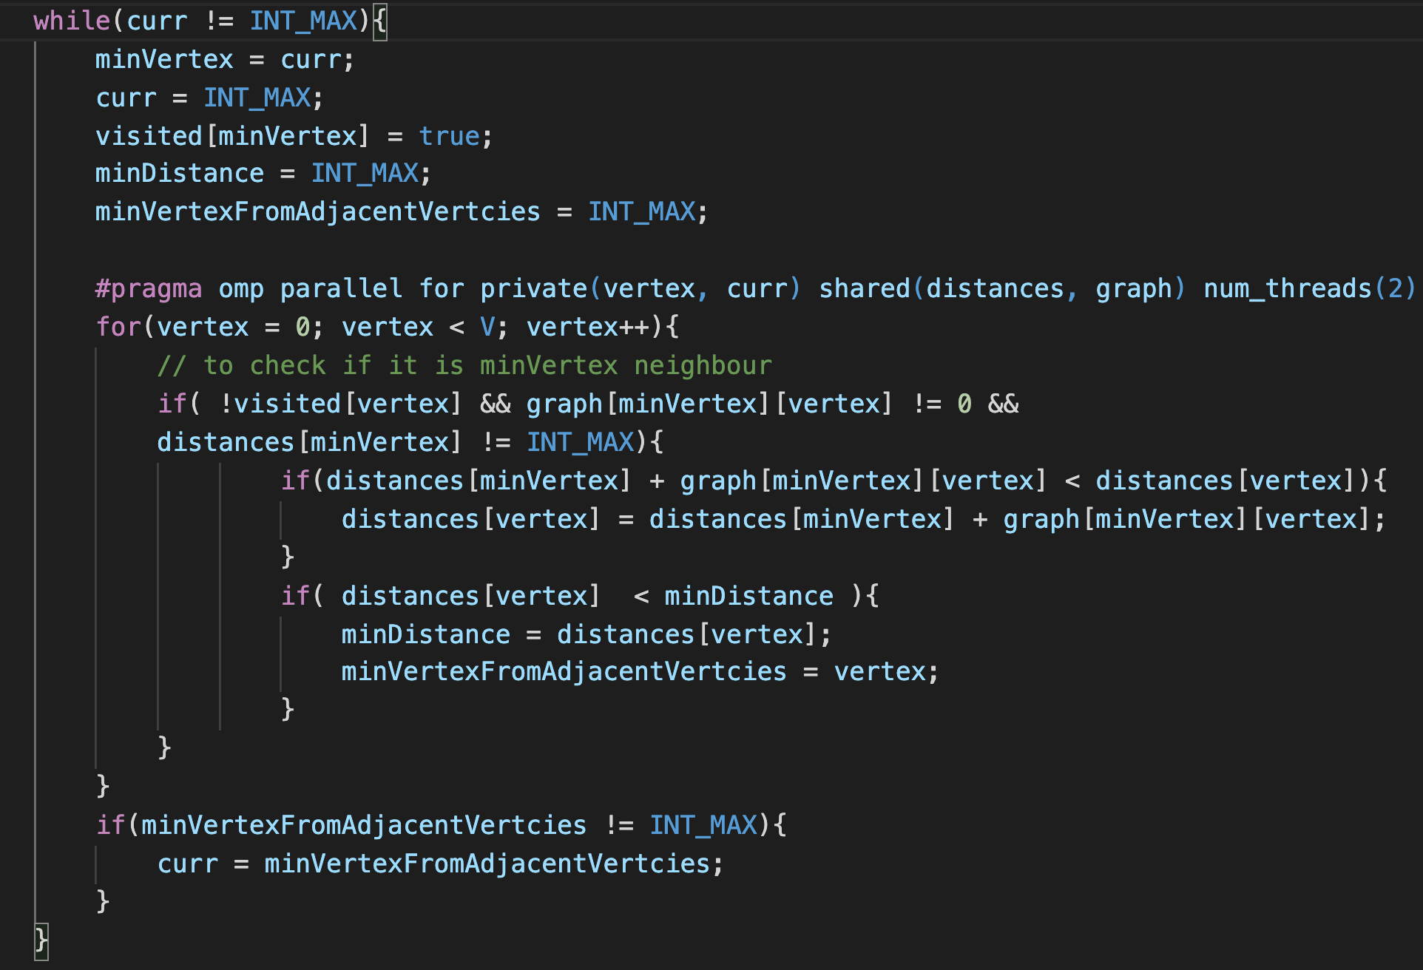
Dijkstra Algorithm Pseudocode
Dijkstra(Graph, source): for each vertex v in Graph: dist[v] ← INT_MAX visited[v] ← false dist[source] ← 0 curr ← source while curr is not INT_MAX: minVertex ← curr (get the vertex with min dist[curr:n]) set visited[minVertex] to true set curr to INT_MAX set minVertexFromAdjacentVertcies to INT_MAX for all of the vertices: if neighbor v of minVertex & v is not yet visited: if dist[minVertex] + grap(u, v) < dist[v] dist[v] ← dist[minVertex] + graph(minVertex, v) if distances[v] < minDistance minDistance ← distances[v]; minVertexFromAdjacentVertcies ← v; if minVertexFromAdjacentVertcies is not INT_MAX curr ← minVertexFromAdjacentVertcies

Slide 15
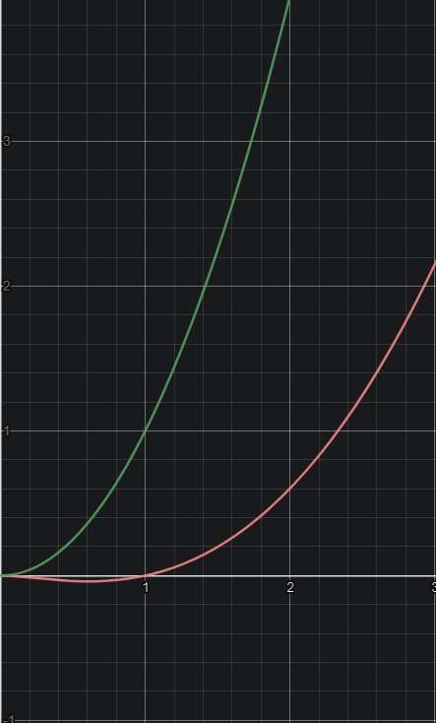
Our first Dijkstra’s algorithm
For our first, less efficient implementation of a sequential Dijkstra’s algorithm, we mainly used an array structure instead of the usual minimum priority queue.
We then parallelized that algorithm, resulting in an increase in computational complexity.

Slide 16
Our next Dijkstra’s algorithm
Later, in order to improve our sequential algorithm, we moved onto using a boolean array to keep track of the visited array, as well as using a distance array to implement it.
Due to these newly implemented arrays, the computational complexity of the sequential algorithm was shortened down to O(V^2).
In our attempt to parallelize said algorithm, we ran into the problem of being unable to fully parallelize the algorithm.

Slide 17
Problems we faced in parallelizing Dijkstra’s algorithm
We ran into an issue in which we were not able to fully parallelize the improved sequential algorithm.
There was also an issue with how we set up our thread creation for our second attempt at a parallel Dijkstra’s algorithm which led to a number of thread equivalent to the starting number of threads to be initialized in each loop, increasing the overhead cost of winding up threads each loop.
This led to a stark difference between the theoretical performances of the algorithms compared to their real world performances.

Slide 18
How BFS Works ?
Let's take an example….
Find the shortest path from 2 to 5
0
1
2
3
4
5

Slide 19
How BFS Works ?
J=2
Visited:
Prev:
Index:
Queue: 0,4
0
False
False
True
False
False
False
1
2
-127
-127
-127
-127
-127
-127
0
1
2
3
4
5
3
4
5
Current Vertex Adjacent Vertices Unvisited Vertices Processed Vertex

Slide 20
How BFS Works ?
J=0
Visited:
Prev:
Index:
Queue: 4,1
0
True
False
True
False
True
False
1
2
2
-127
-127
-127
2
-127
0
1
2
3
4
5
3
4
5
Current Vertex Adjacent Vertices Unvisited Vertices Processed Vertex

Slide 21
How BFS Works ?
J=4
Visited:
Prev:
Index:
Queue: 1,3,5
0
True
True
True
False
True
False
1
2
2
0
-127
-127
2
-127
0
1
2
3
4
5
3
4
5
Current Vertex Adjacent Vertices Unvisited Vertices Processed Vertex

Slide 22
How BFS Works ?
J=1
Visited:
Prev:
Index:
Queue: 3,5
0
True
True
True
True
True
True
1
2
2
0
-127
4
2
4
0
1
2
3
4
5
3
4
5
Current Vertex Adjacent Vertices Unvisited Vertices Processed Vertex

Slide 23
How BFS Works ?
J=3
Visited:
Prev:
Index:
Queue: 5
0
True
True
True
True
True
True
1
2
2
0
-127
4
2
4
0
1
2
3
4
5
3
4
5
Current Vertex Adjacent Vertices Unvisited Vertices Processed Vertex

Slide 24
How BFS Works ?
J=5
Visited:
Prev:
Index:
Queue:
0
True
True
True
True
True
True
1
2
2
0
-127
4
2
4
0
1
2
3
4
5
3
4
5
Current Vertex Adjacent Vertices Unvisited Vertices Processed Vertex

Slide 25
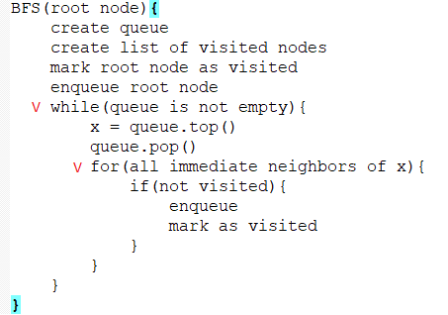
Our parallelized BFS algorithm
Consider this pseudocode of a BFS traversal...

Slide 26
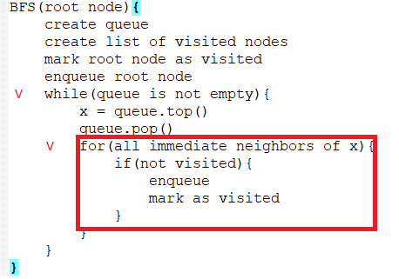
Our parallelized BFS algorithm
Consider this pseudocode of a BFS traversal…
Sequential version has V^2 time complexity

Slide 27
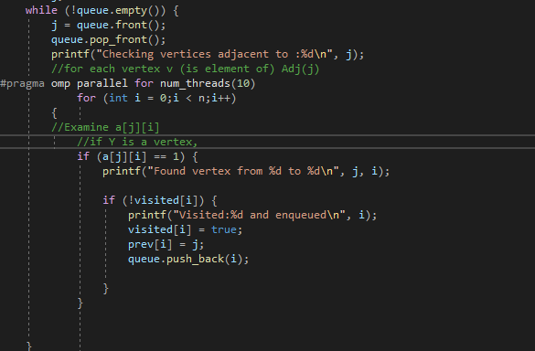
Our parallelized BFS algorithm

Slide 28
Problems we faced ?
I wasn’t able to implement BFS using an adjacency list. Which would’ve had a O(V+E) time complexity
The adjacency matrix version has O(V^2) time complexity, but I saw an opportunity to parallelize it

Slide 29
Our parallelized BFS algorithm
Parallelizing BFS was a similar situation.
The parallelized BFS algorithm would process every vertices of a single level at the same time, and then repeat that process onto the next level and so forth with a for loop.
Similar to our first try at Dijkstra’s algorithm in which we used a queue, a priority queue data structure to be specific, we used a regular data queue structure due to the fact that BFS works with unweighted graphs and what not.

Slide 30
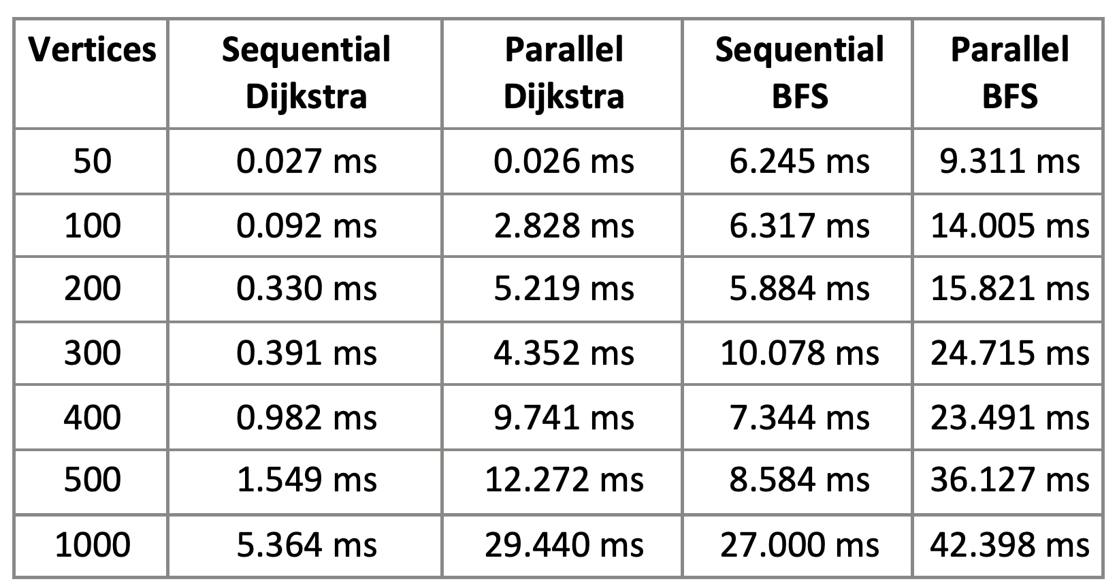
Performances of each algorithm
Large amount of vertices were used due to the fact that the overhead time costs of winding up threads would make it so that the sequential algorithms were more time efficient.
However, despite data inputs increases, the parallelized algorithms failed to show improvements in runtime, and this due to to problem we faced in our inability to fully parallelize each algorithm.
To slightly improve performance, we fixed the number of threads being created to a constant value of two.
The overhead cost of initializing an additional two threads each loop made it so that the parallel algorithms were less efficient than the sequential algorithms.
Results from our first algorithms

Slide 31
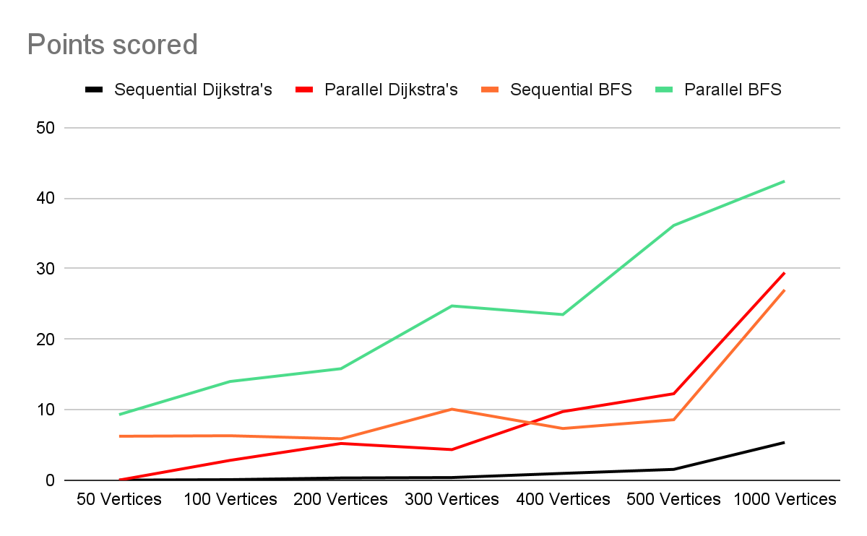
Performance of each algorithm: Graph
Paste it here!

Slide 32
Real world Performances of each algorithm
A parallelized Dijkstra’s algorithm, due to its nature, is ill suited for small scale tasks, and can be used to its potential with large scale software applications such as a Global Positioning System and what not.
Parallelized BFS would be much more suited for mapping out and/or searching for a certain file within a directory.

Slide 33

Thanks
Big success, good job!
No questions.

